Slide 1
Shading
Haley, Stefani, & Emily

Slide 2
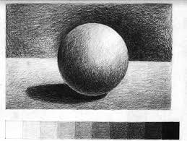
What is shading?
The use of light and dark values to give the illusion of form and depth.
A very slight variation, typically in color.

Slide 3
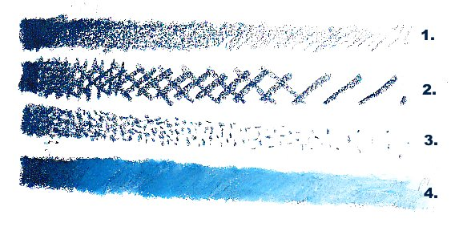
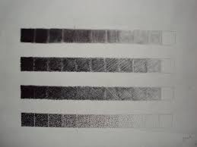
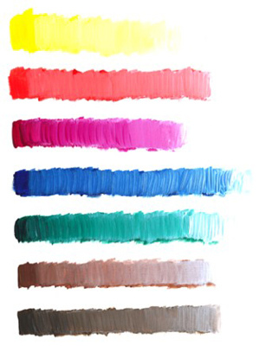
With What Can Shading be Used
Pencil/pen
Marker
Paint
Charcoal
Oil pastel
Chalk pastel
Pen and Ink

Slide 4
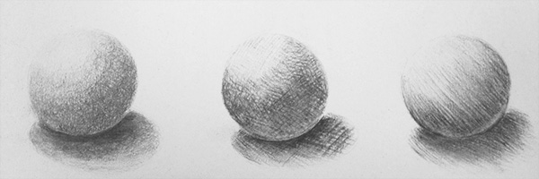
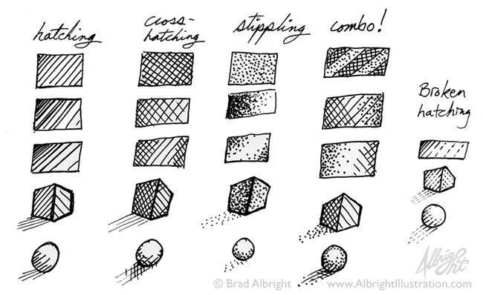
Shading Techniques
Hatching
Cross-hatching
Stippling

Slide 5
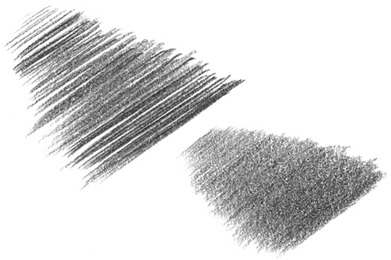
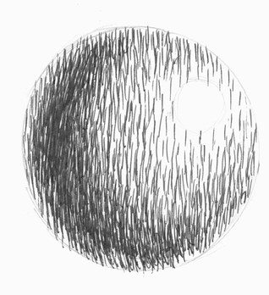
Hatching
The shading of an area with closely drawn parallel lines.

Slide 6
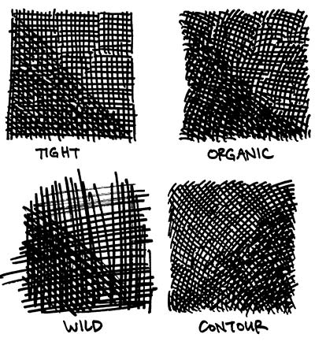
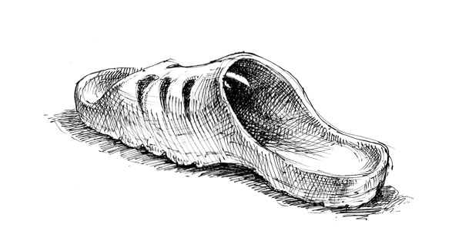
Cross-Hatching
The shading of an area with intersecting sets of parallel lines

Slide 7
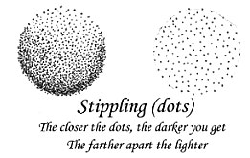
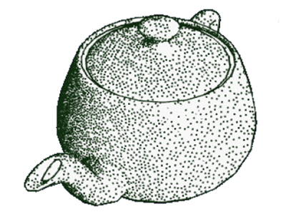
Stippling
The marking of a surface with numerous small dots or specks.

Slide 8
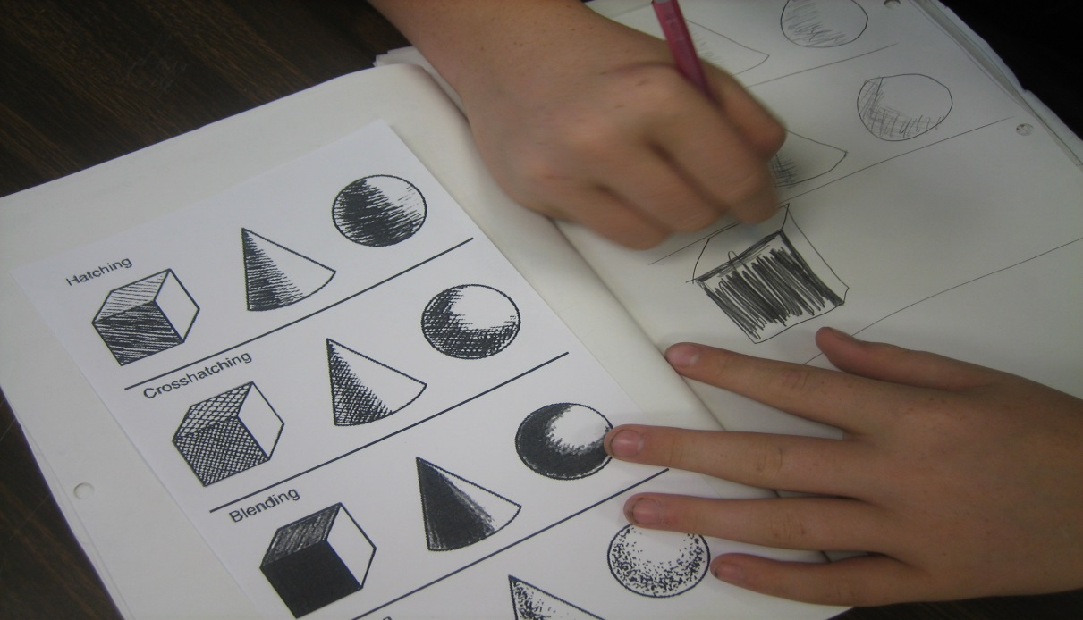
Lets practice
You will need:
Pen/pencil or some type of writing material
Paper
Items that contain texture. (optional)

