Slide 1
Native American Coil Pots
Miss Rheault and Miss Sumption

Slide 2
History
In historical Native American culture ceramics played a very important role. Ceramics is still important in this culture today. Native Americans used clay to make pots for cooking and storage, bowls for eating, and sculptures for artistic expression.

Slide 3
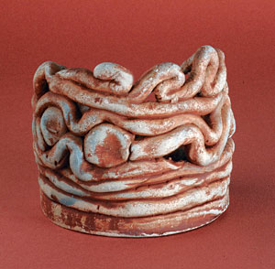

Slide 4
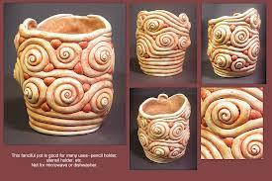

Slide 5
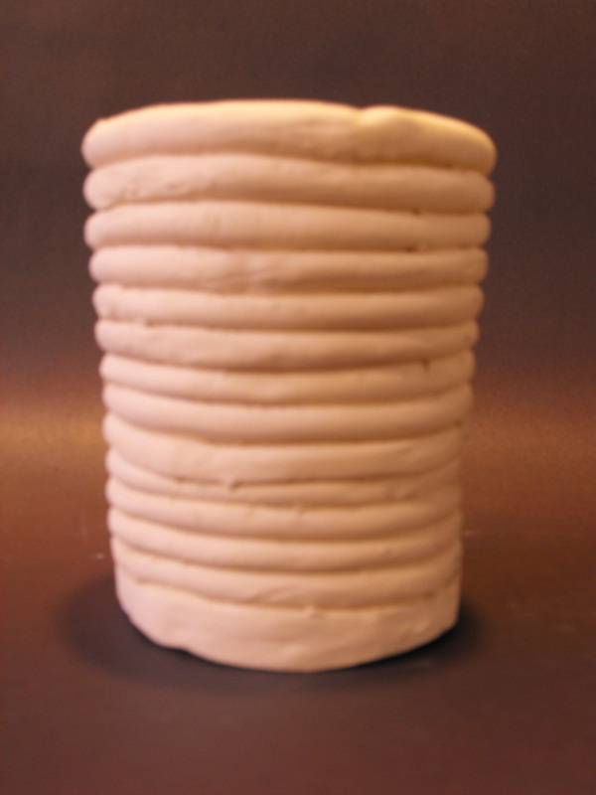

Slide 6
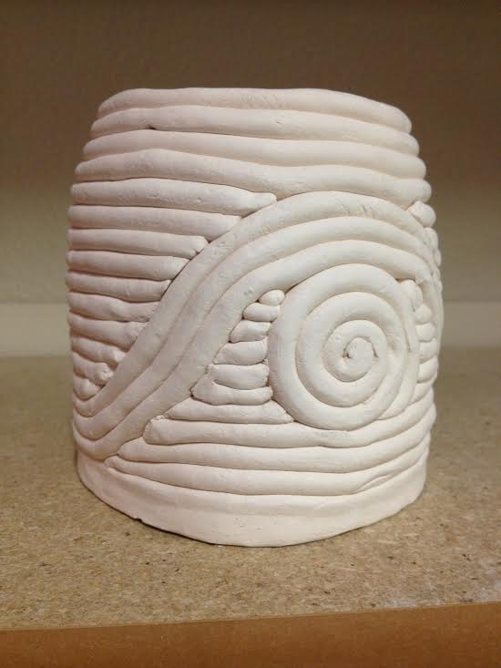

Slide 7
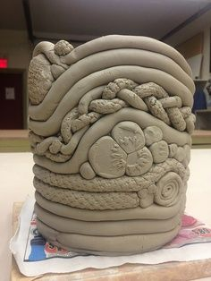

Slide 8
