Slide 1
Scratchboard Art

Slide 2
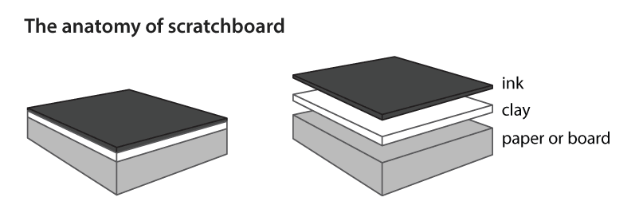
What is a scratchboard?
A piece of paper or board is coated with clay and then sprayed with a layer of black ink

Slide 3
Rhythm/Movement
Suggestion of motion through the use of various elements

Slide 4
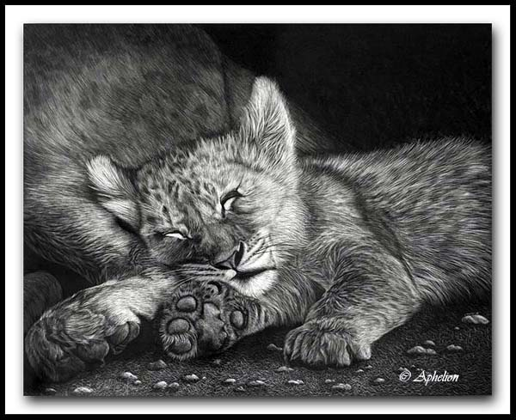
Texture
The feel, appearance, or consistency of the surface of an object

Slide 5
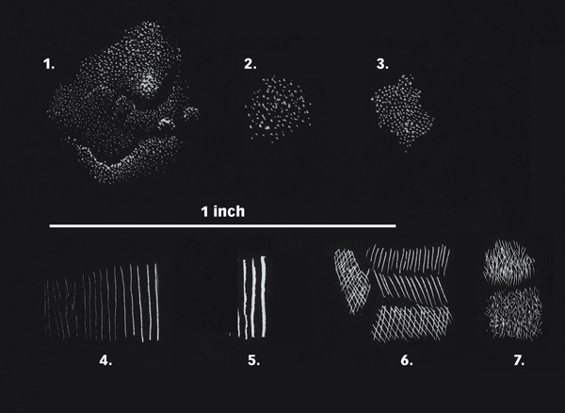

Slide 6
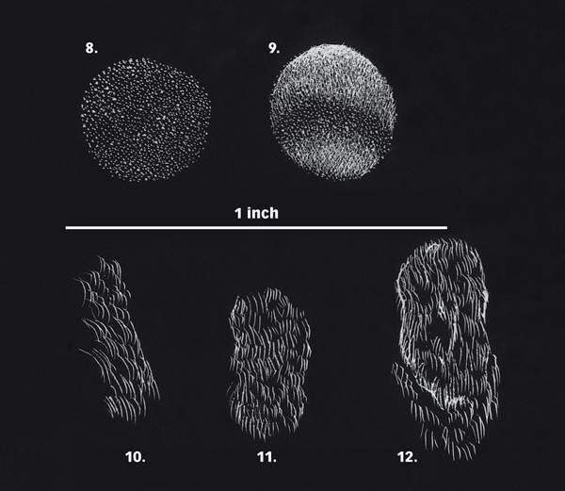

Slide 7
Value
The lightness or darkness of a tone of a color and is perceived in varying levels of contrast

Slide 9
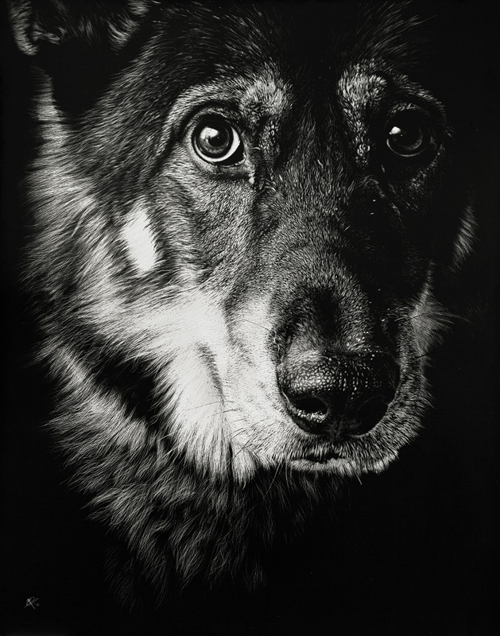
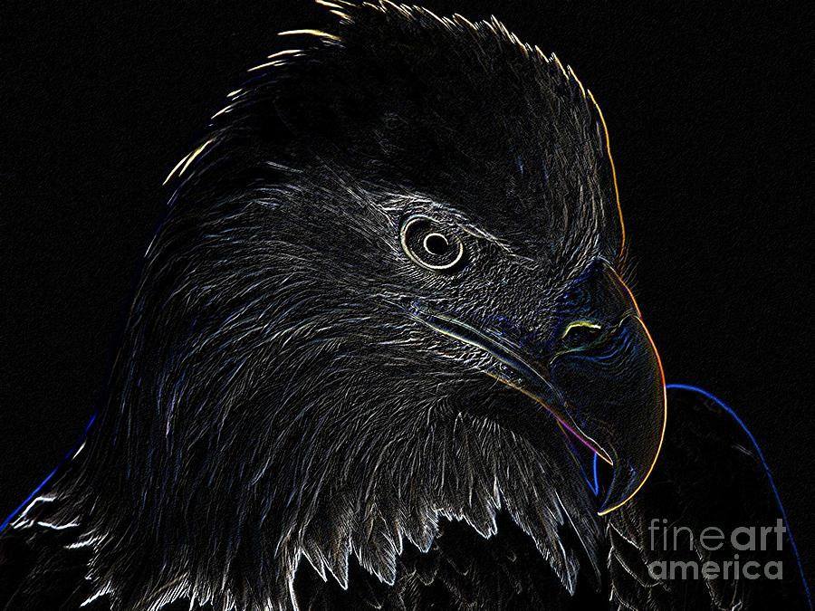

Slide 10
