Slide 1
Shading

Slide 2
Value Scale

Slide 3
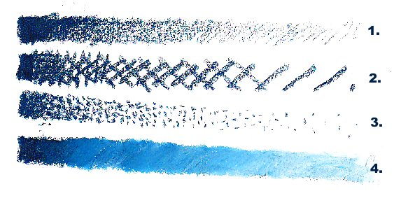
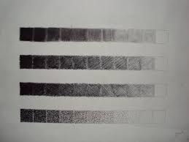
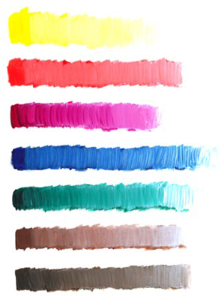
With What Can Shading be Used
Pencil/pen
Marker
Paint
Charcoal
Oil pastel
Chalk pastel
Pen and Ink

Slide 4
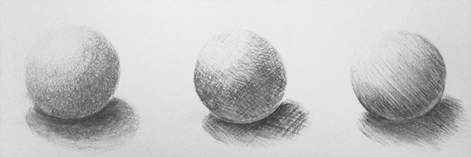
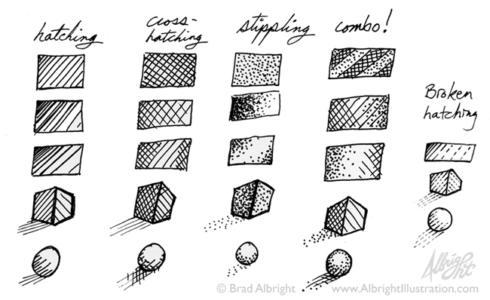
Shading Techniques
Hatching
Cross-hatching
Stippling
Blending

Slide 5
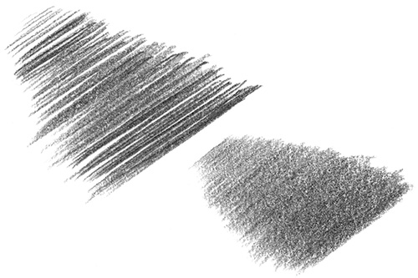
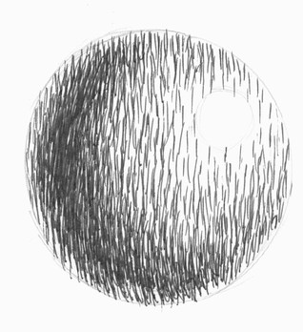
Hatching
The shading of an area with closely drawn parallel lines.

Slide 6
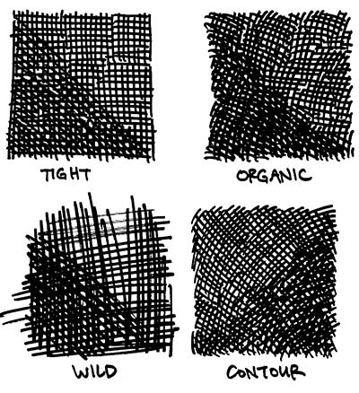
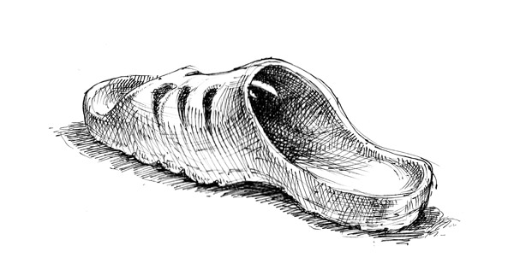
Cross-Hatching
The shading of an area with intersecting sets of parallel lines

Slide 7
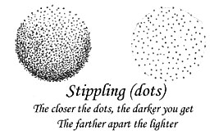
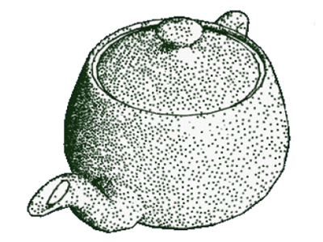
Stippling
The marking of a surface with numerous small dots or specks.

Slide 8
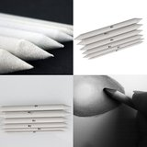
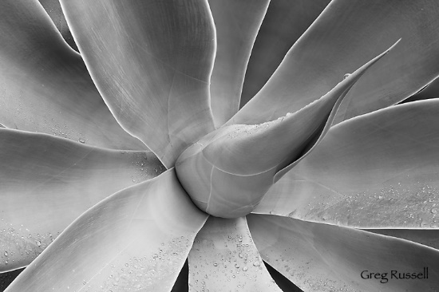
Blending
Applying your color and rubbing area with tortillon or finger.

Slide 9
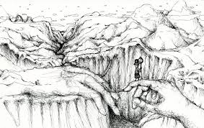
Handscapes

Slide 10
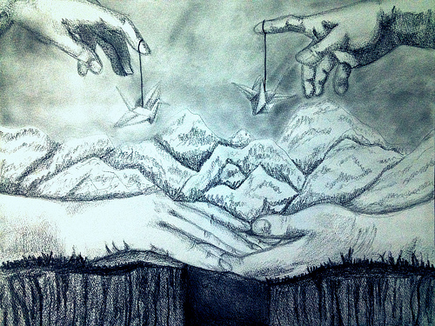
Handscapes

