Slide 1
Patterns with the masters

Slide 2
Pattern
Repeating visual elements such as line, shape, color, texture, or image.
Unifies whole work and creates rhythm.

Slide 3
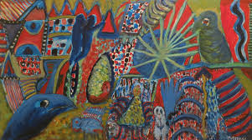
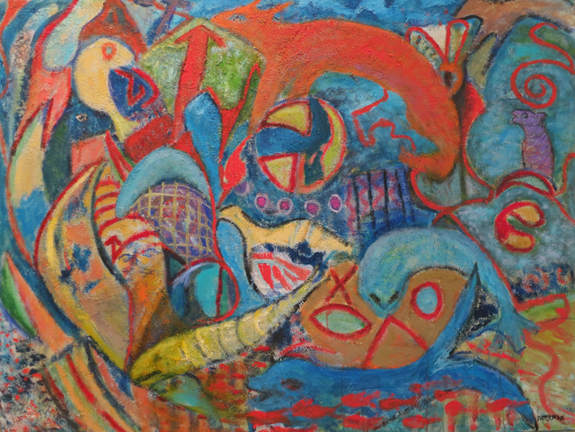
Florence Putterman
Legendary Fables
Numinous Legend V
Myriad Legends

Slide 4
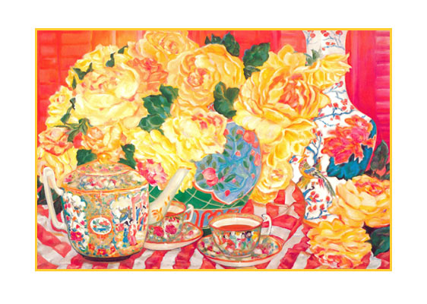
Sara eyestone
Fiesta Picnic
Tea in the Afternoon

Slide 5
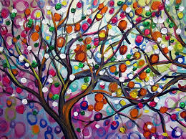
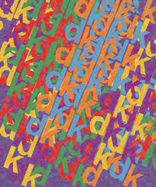
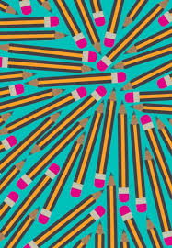
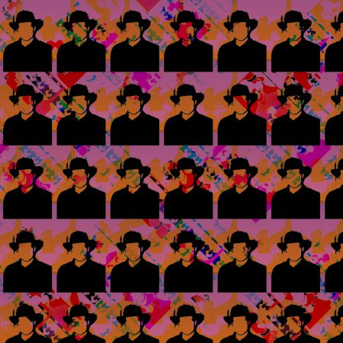
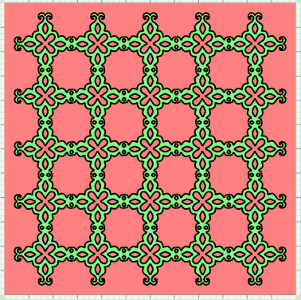
More patterns

