Slide 1
Japanese Notan

Slide 2
Light and dark
Notan is the concept involving the placement of light and dark elements next to the other in the composition of art and imagery.

Slide 3
Japanese folk art
Paper cutting
Many Notan pieces are collaged
Can be created using ink, paint, or in modern day creations, the use of computers

Slide 4
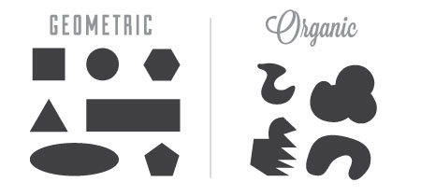
Space and shapes
Positive and negative space
Organic and geometric
shapes

Slide 5
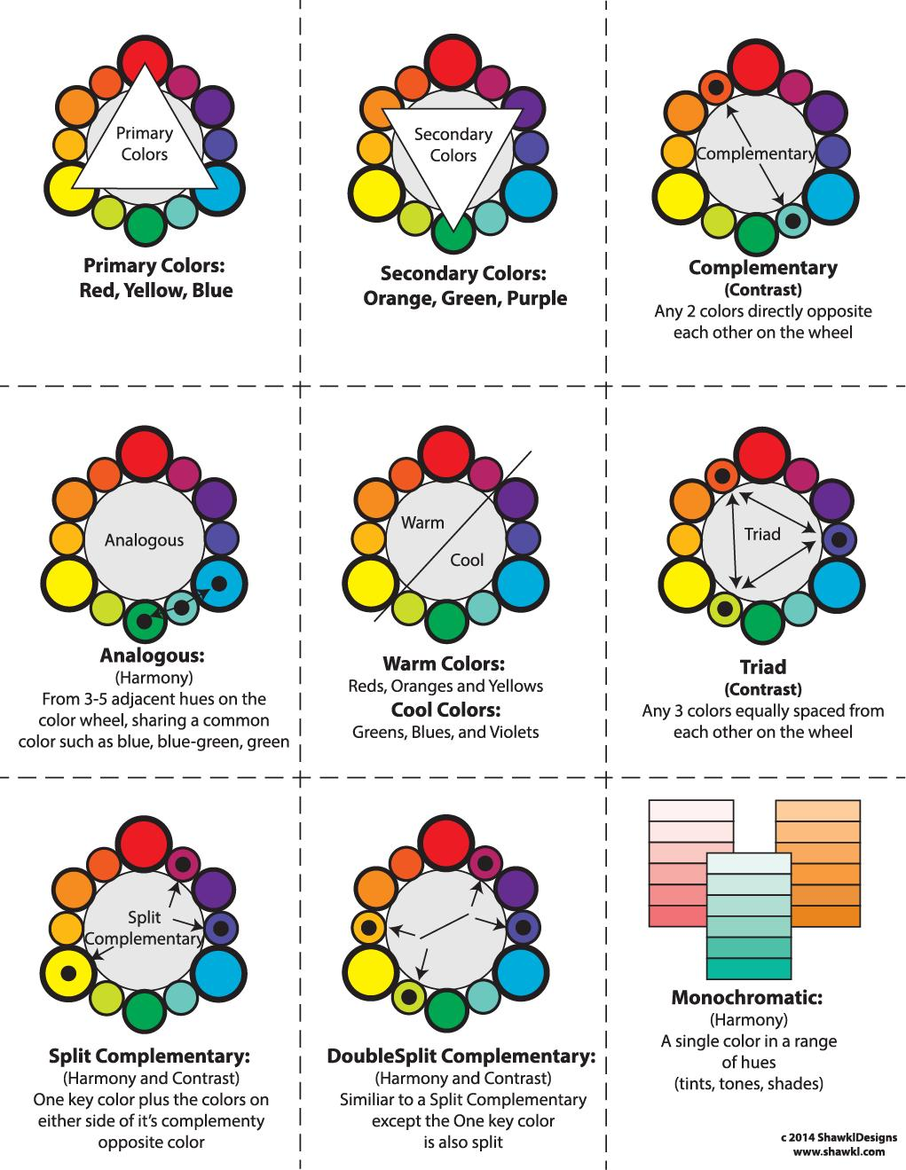
Color scheme

Slide 6
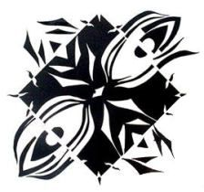
examples

